Slide 1
Overfitting solutions
Husnain Haider

Slide 2
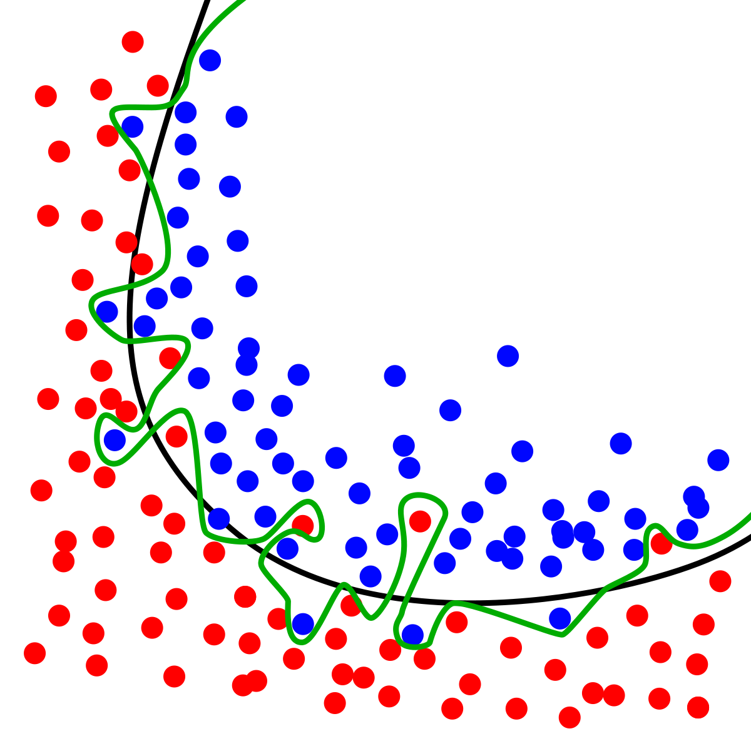
Overfitting?
Overfitting is when machine learning model learns specific patterns of the training data and performs bad on unseen data
Image Curtsey: Wikipedia

Slide 3
Diagnosis
Results on training data are way different from testing data
For example, a model gives 99.9% accuracy on training data but only 50% accuracy reported on test set, we call this overfitting

Slide 4
Possible solutions
Validation set
Increase data
Less parameters
Regularization
Early stopping

Slide 5
Validation set
Instead of splitting data in only training and texting sets, must split data into training, validation and testing sets
Validation data will be used to test the model learning on every iteration during training process
It will prevent the model to be biased towards training data

Slide 6
Increase data
More data, more variation
More variation in data, less biasness

Slide 7
Less parameters
More trainable parameters in model, more chances of fitting the noise
Reduce the number of parameters according to problem.

Slide 8
Regularization
Every machine learning model have an objective function
Add a regularization term in function which leads towards more error when overfitting
For example in polynomial curve fitting
Objective error function
Error function with regularization

Slide 9
Early stopping
With validation set, when model’s error stop decreasing on validation set but keep decreasing for training set, it indicates overfitting
Stop training at that time

